Slide 1
Analyzing Weather Data for Climate Change Trends
Can we make a case for climate change by reviewing hurricane, temperature and droughts data for the past 50 years?
Team 1:
Andy, Ivan, Ramees, Saleha

Slide 2
Setting Context
Climate scientists have been warning us of a global rise in temperature
Increased carbon emissions over the post industrial revolution and in 20th century
Greenhouse effect and its effects: ozone, rising temps, floods
How easily can we infer this from weather data of last few decades?
The urgency of the climate change question

Slide 3
1.5 C
2001-2010
Strange weather patterns
42108/150388
Temperature change in last 6 decades
The warmest decade on record
No of threatened marine life

Slide 4
Overview of our analysis
Hurricanes
We will use 50 years data
Atlantic Ocean
Review hurricane category
Look at the location distribution for landfall events
Identify frequency over time
See how this can impact commodities
Droughts
We will use 50 years data
Continental United States
Review droughts by severity
Look at the location distribution
Identify frequency over time
See how droughts can impact commodities
Temperature Extremes
We will use 50 years’ temp data
British Columbia
Review the variance in extreme temps over time
Cross-reference heat data with occurrence of wildfires

Slide 5
Data Analysis - Hurricane

Slide 6
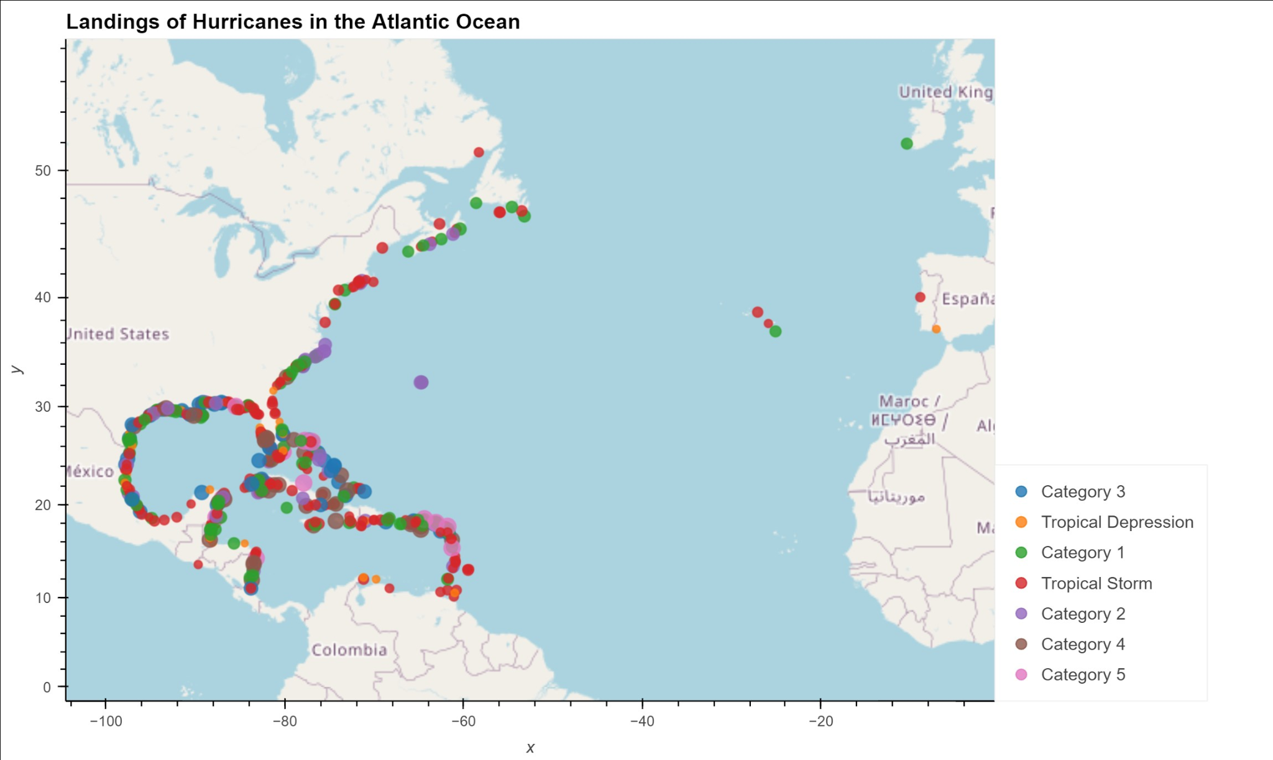
Hurricanes in Atlantic
Figure 1. Shows the occurrence of hurricanes in the Atlantic ocean, if and where they make landfall. The vast majority of hurricanes hit the east coast of US and Mexico.

Slide 7
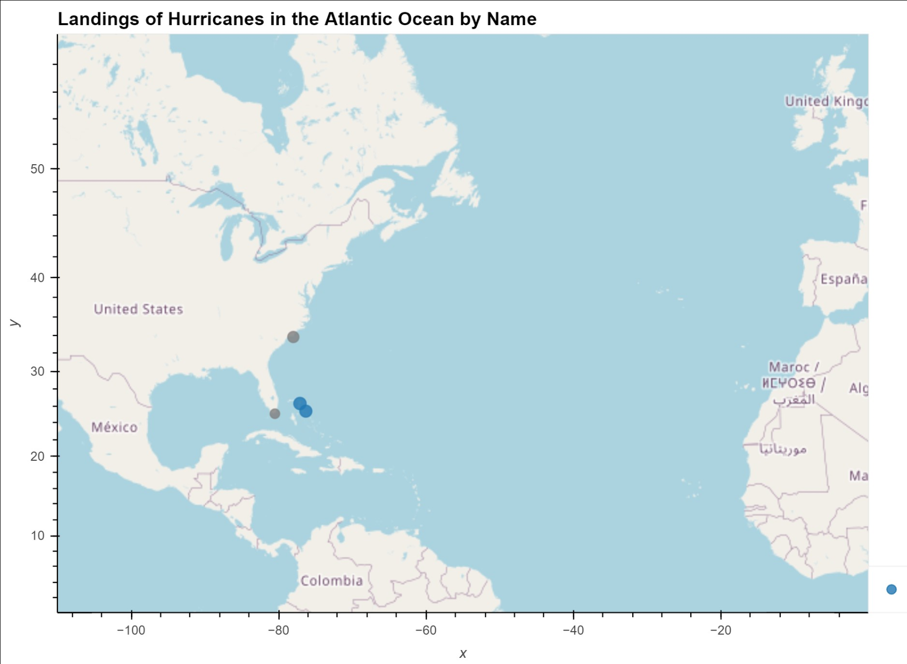
Our Approach - I
We analyzed hurricane data for the Atlantic over last 50 years
Hurricanes have 7 classifications based on wind speed
We constructed a function to categorize the hurricanes data
We then created a chart to select the hurricane by name to view its progression as it lands in different spots

Slide 8
Our Approach - II
We then grouped the data by decade and category of storm
The final dataframe shows the frequency of hurricanes by decade for each category
The final data set was used to create a bar plot to reflect the frequency against the decade

Slide 9
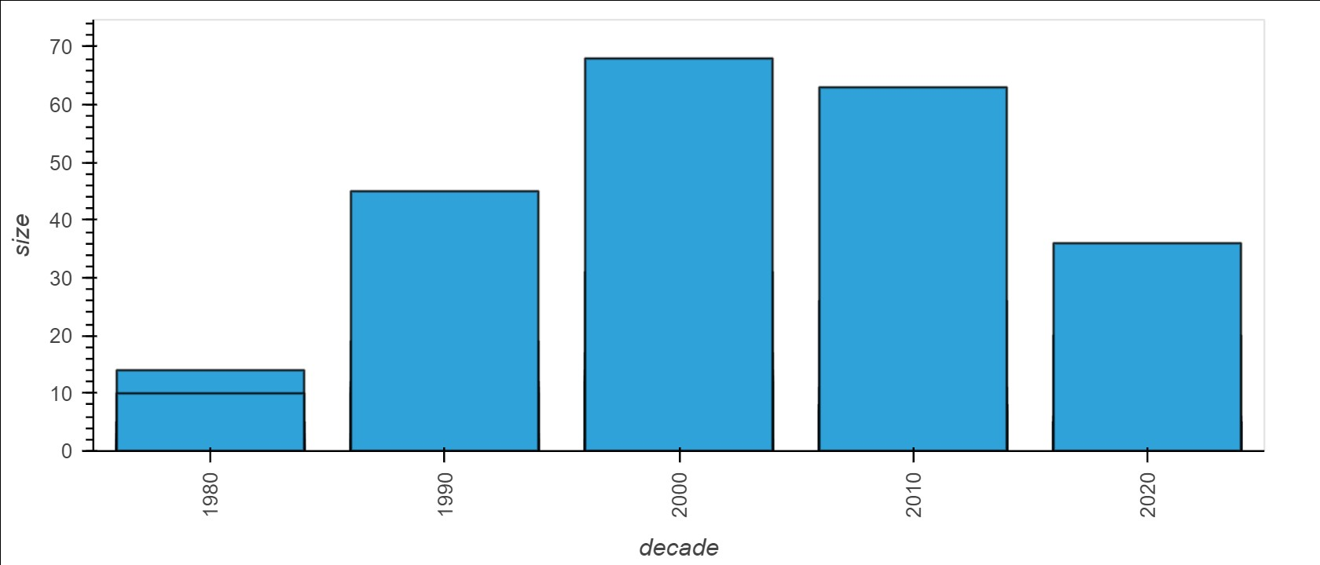
Our findings - I

Slide 10
Our findings - II
The frequency of hurricanes peaked in 2000s slightly dipping in 2010s
Over time the frequency has increased
It’s already halfway the 2000s peak value and we are in early 2020s
Corroborates the fact that hurricanes are caused by warm ocean air rising to create low pressure “vacuum” areas
Intensity has been increasing as well

Slide 11
Data Analysis - Droughts

Slide 12
Droughts in United States
We look at historical droughts data to identify trends over time by state to see if:
Drought intensity has increased over time
Where these changes have occurred
Drought occurrence has increased over time

Slide 13
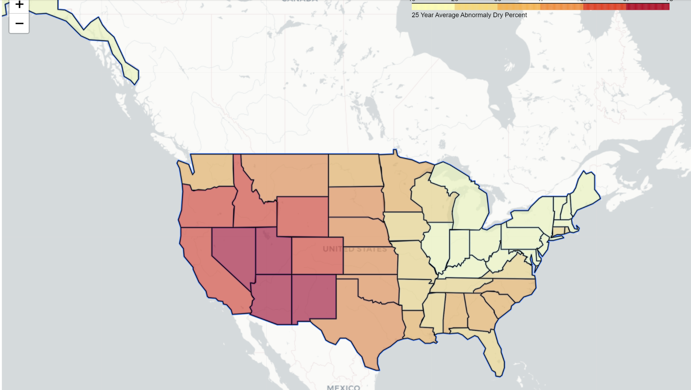
Our approach
Categorize the drought data into 3 types: Abnormally dry, severe drought, extreme drought
Show the trends over time for each state
Calculate the mean of the droughts

Slide 14
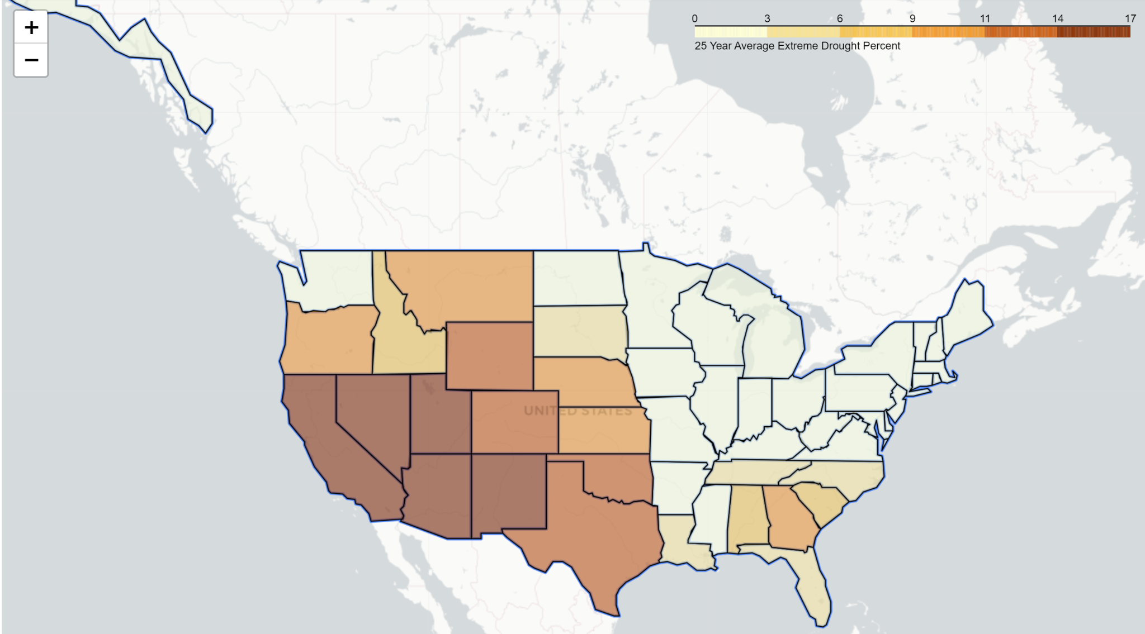
Findings - I
The states that have the highest extreme drought percentage are the Southwestern States and California.

Slide 15
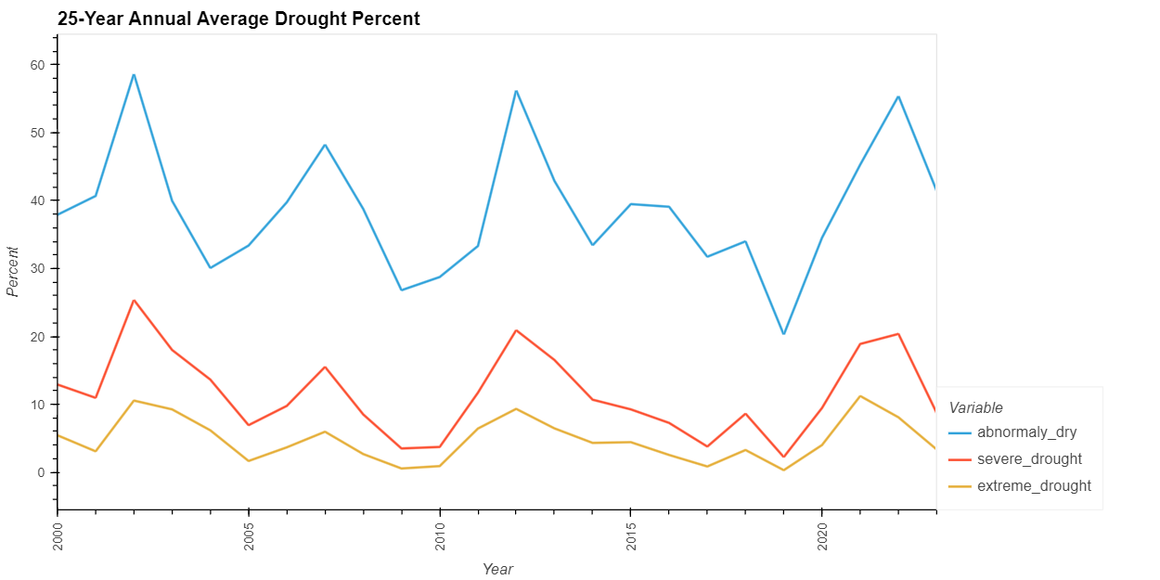
Findings - II
There isn’t a marked change in droughts that can be observed from the data over past 23 years

Slide 16
Data Analysis - Temperature

Slide 17
Analyzing temperature data for BC
BC has come under scrutiny of late for extreme temps and we wanted to analyze 50 years of daily temp data to see whether there has been increase in temperature extremes there
We also see what the trend for wildfires is over last decade in light of temperature data
Try to identify correlations between seasons and temperature extremes

Slide 18
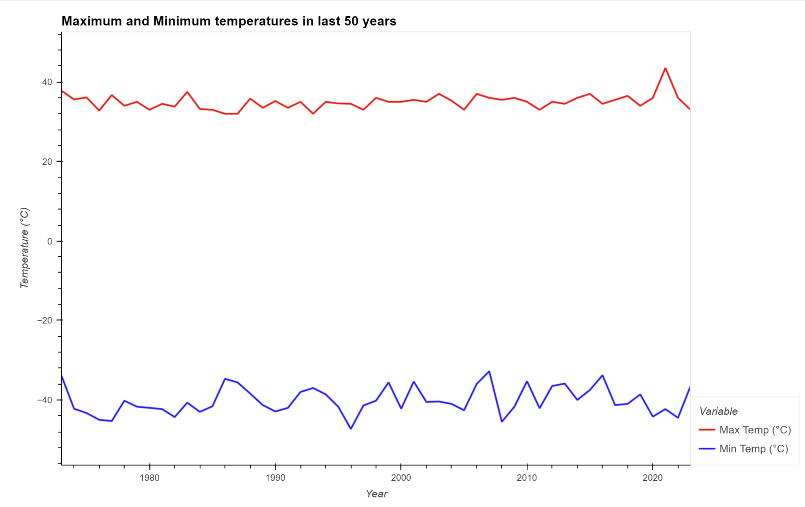
Temperature Variance for 50 yrs
Temperature variations show small recent spikes but it’s not sufficient to show major and steady changes

Slide 19
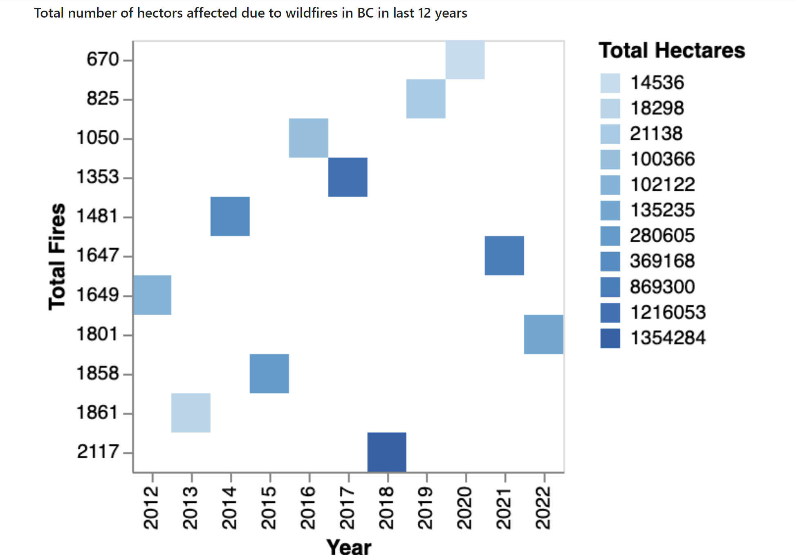
Wildfires Occurrence
There seems to be some increase in severity of wildfires over time as the area (in hectares) affected seems to be increasing

Slide 20
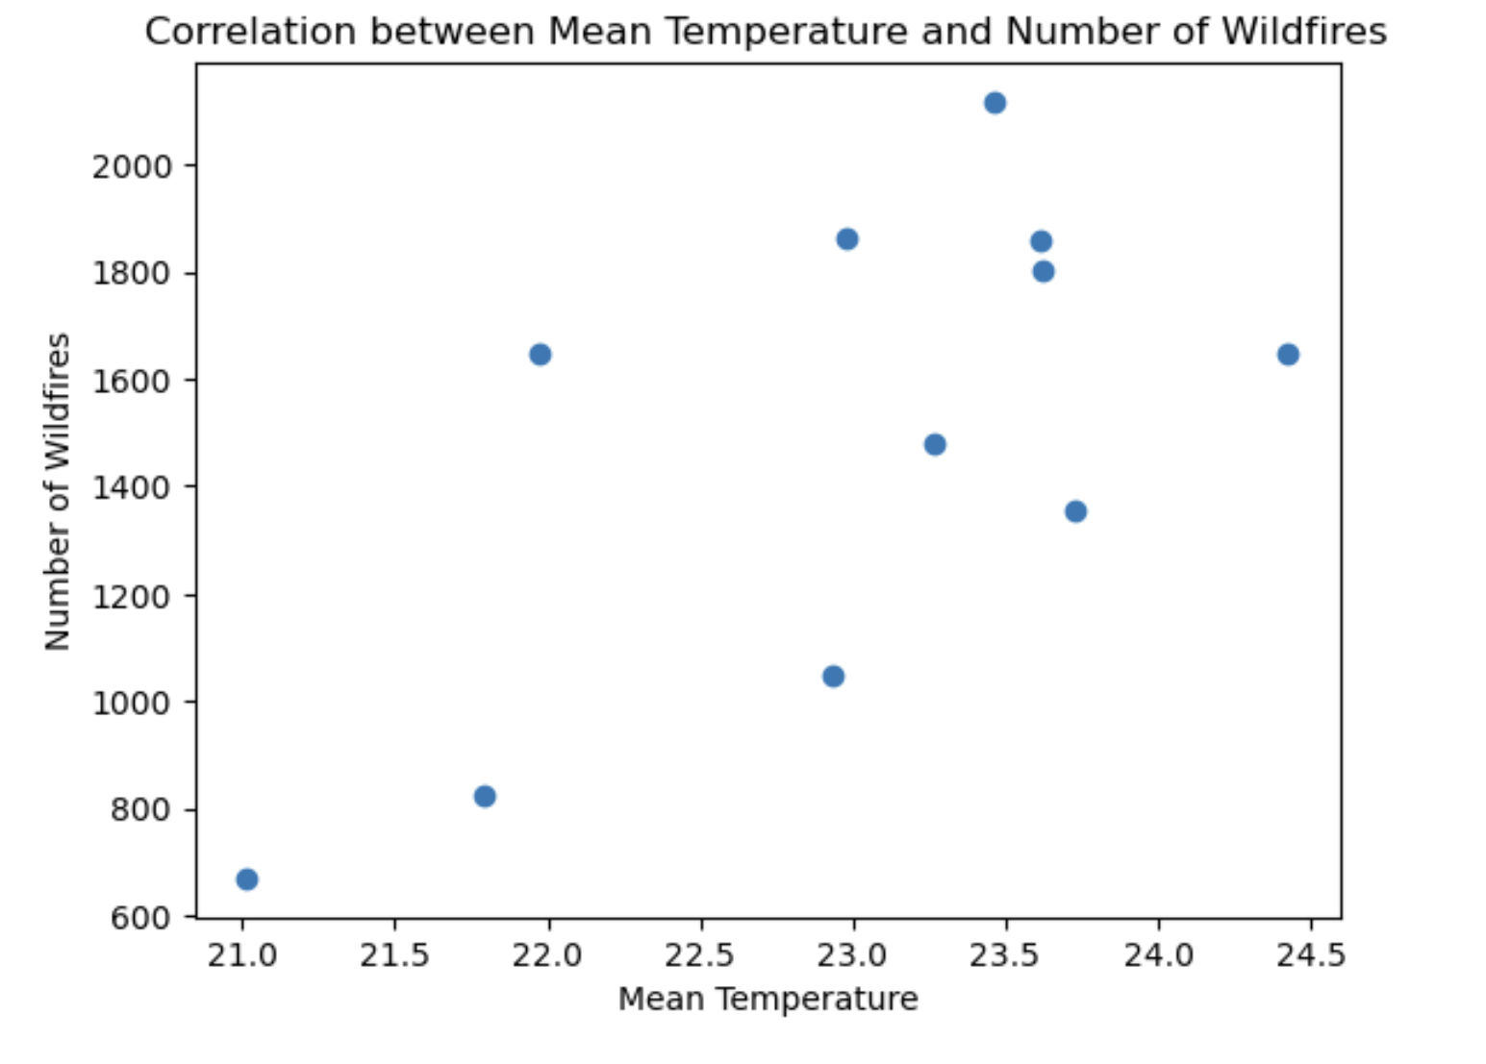
Plot of the correlation - moderate correlation of 0.67

Slide 21
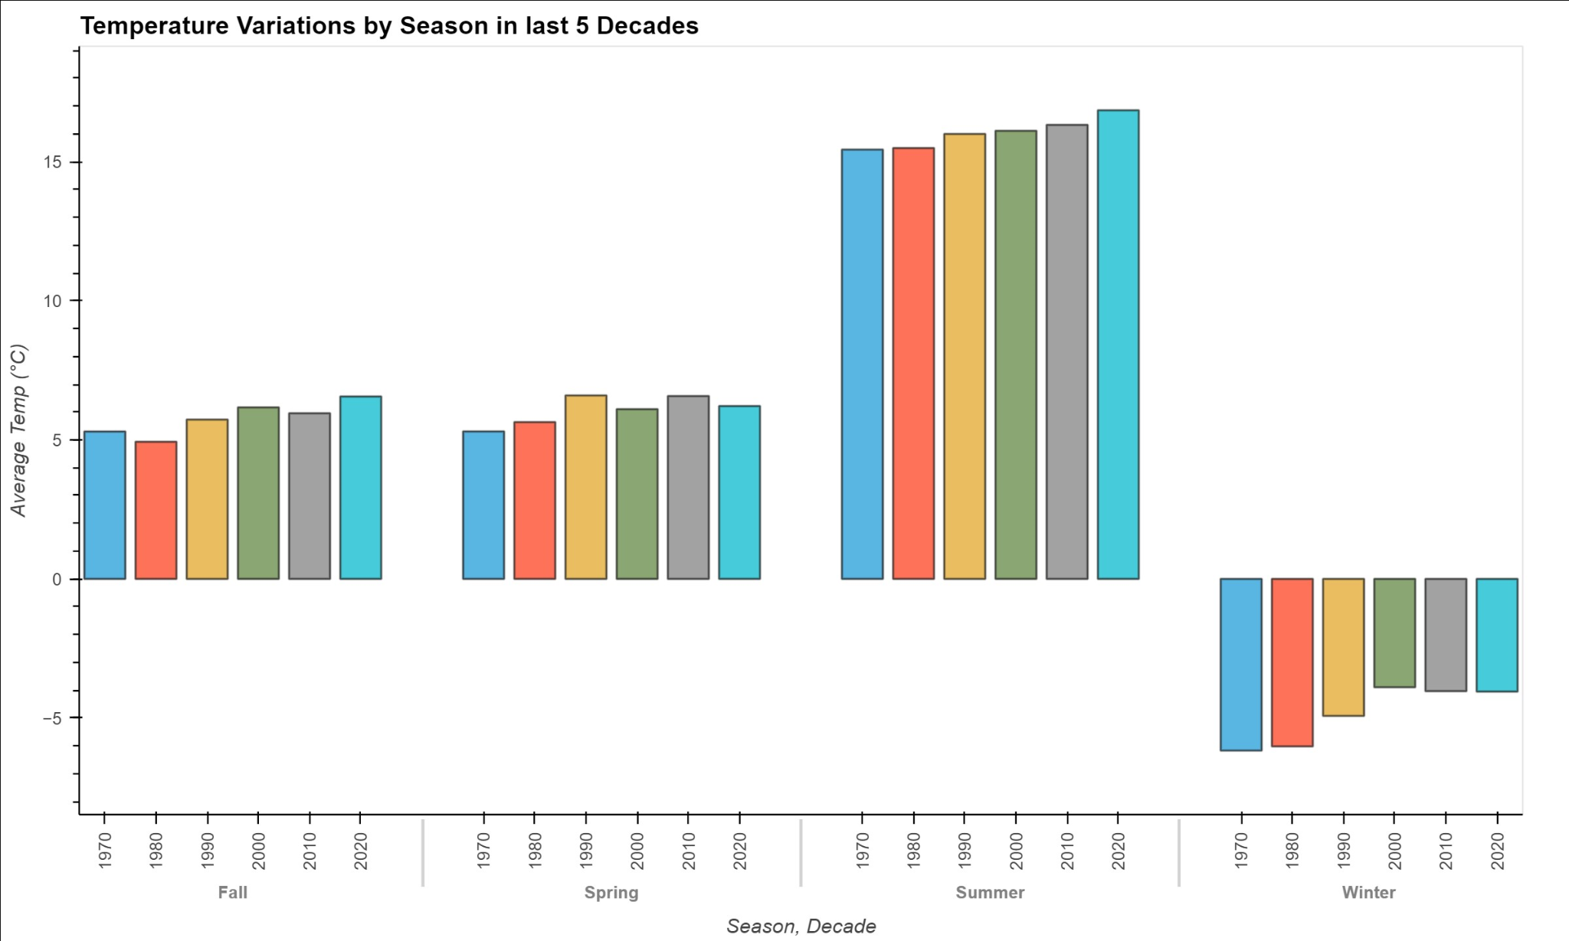
Temperature Variance by Seasons
By examining the figure above, the average temperature for each season is increasing each decade.

Slide 22
Effects on Business

Slide 23
Effects of hurricanes on commodities
Approach: We intook data for gas prices and cross-referenced it to the hurricane occurrences
We found that there were instances where the prices were both negatively and positively correlated with the hurricane occurrence
Conclusion: Other factors must be at play to affect the gas prices

Slide 24
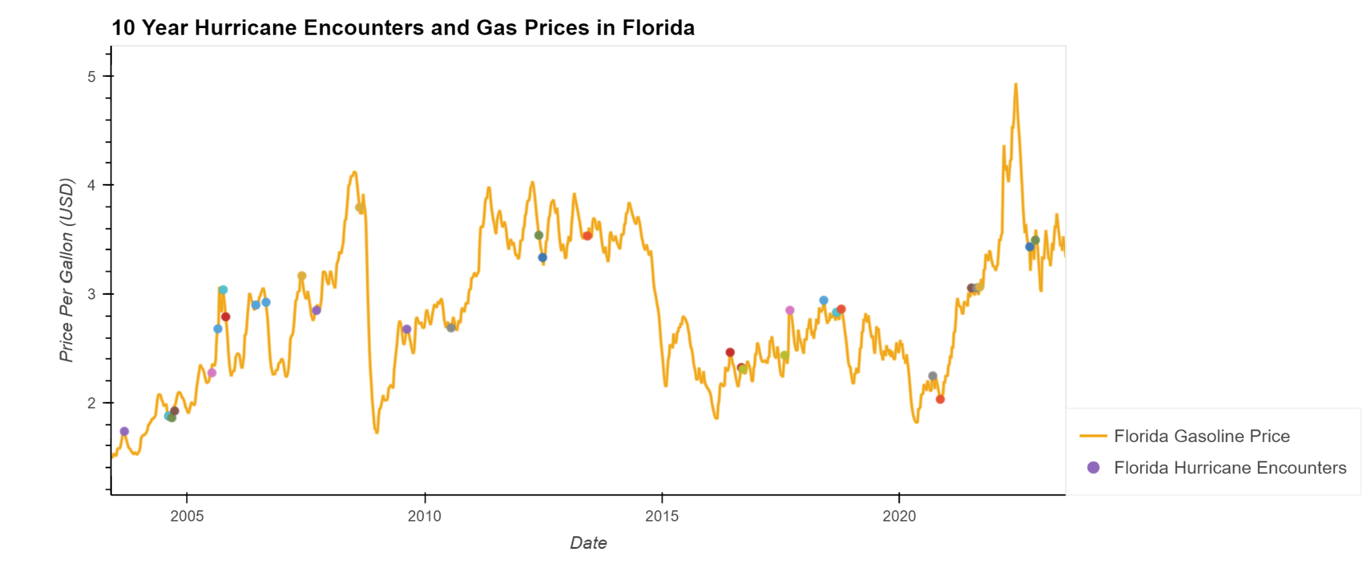
There seems to be no determinate relationship between Hurricane & Gas Prices

Slide 25
Effects of wildfires on stocks
It is input driven and needs to be completed in Jupyter Notebook
The data doesn’t show a meaningful relationship between wildfires in BC and the regional prices of commodities

